Slide 1
Chapter-3
Agile Development

Slide 2
Extreme Programming XP
Developed by Kent Beck :
  XP is “a light-weight methodology for small to medium-sized teams developing software in the face of vague or rapidly changing requirements.”
Alternative to “heavy-weight” software development models
(which tend to avoid change and customers)
  "Extreme Programming turns the conventional software process sideways. Rather than planning, analyzing, and designing for the
  far-flung future, XP programmers do all of these activities a little
  at a time throughout development.”
  -- IEEE Computer , October 1999

Slide 3
Embrace Change
In traditional software life cycle models, the cost of changing a program rises exponentially over time
A key assumption of XP is that the cost of changing a program can be hold mostly constant over time
Hence XP is a lightweight (agile) process:
  Instead of lots of documentation nailing down what customer wants up front, XP emphasizes plenty of feedback
  Embrace change: iterate often, design and redesign, code and test frequently, keep the customer involved
  Deliver software to the customer in short (2 week) iterations
  Eliminate defects early, thus reducing costs

Slide 4
Four Core Values of XP
Communication
Simplicity
Feedback
Courage

Slide 5
Four Core Values of XP
Communication
XP emphasizes value of communication in many of
its practices:
  On-site customer, user stories, pair programming,
  collective ownership (popular with open source developers), daily standup meetings, etc.
XP employs a coach whose job is noticing when people aren’t communicating and reintroduce them

Slide 6
Four Core Values of XP
Simplicity
''Do the simplest thing that could possibly work'' (DTSTTCPW) principle
XP restricts developers to design only for immediate needs,
rather than consider future needs. The intent is to create a simple design that can be easily implemented in code.
If the design must be improved, it can be refactored at a later time.

Slide 7
Four Core Values of XP
Feedback
Feedback at different time scales
Unit tests tell programmers status of the system
When customers write new user stories, programmers estimate time required to deliver changes
Programmers produce new releases every 2-3 weeks for customers to review

Slide 8
Four Core Values of XP
Courage
The courage to communicate and accept feedback
The courage to throw code away (prototypes)
The courage to refactor the architecture of a system

Slide 9
Why is it called “Extreme?”
Extreme Programming takes the effective principles and practices to extreme levels.
Code reviews are effective as the code is reviewed all the time.
Testing is effective as there is continuous regression and testing.
Design is effective as everybody needs to do refactoring daily.
Integration testing is important as integrate and test several times a day.
Short iterations are effective as the planning game for release planning and iteration planning.

Slide 10
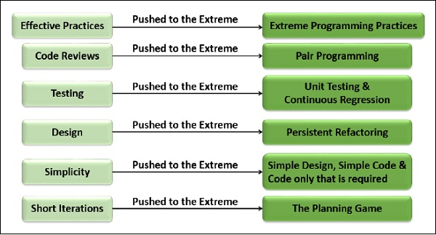

Slide 11
Twelve XP Practices
Whole Team
The Planning Game
Small Releases
Simple Design
Test-driven development
Refactoring
Pair Programming
Collective Ownership
Continuous Integration
40-Hours a Week
On-Site Customer
Coding Standards

Slide 12
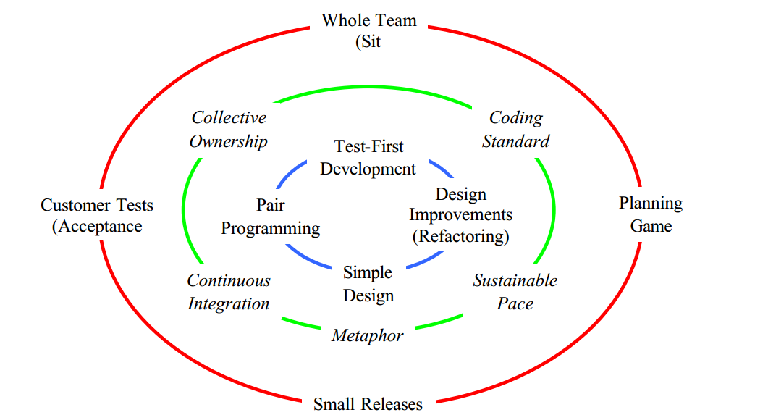
Twelve XP Practices

Slide 13
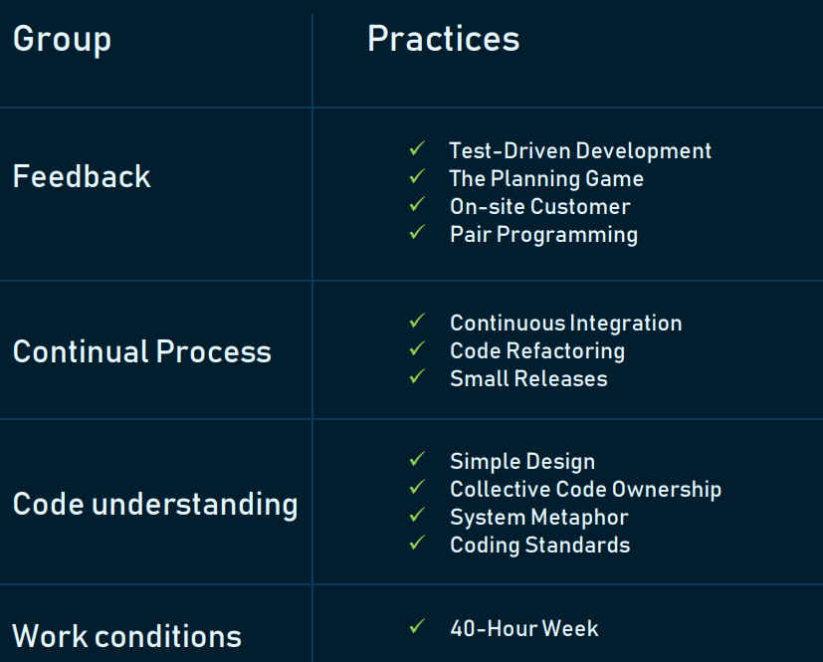
As XP is defined by values and principles, its practices also represent them and can be clustered into four groups

Slide 14
Whole Team
All the contributors to an XP project sit together, as members of one team. This team must include a business representative -- the "Customer" -- who provides the requirements, sets the priorities.
The team will typically include testers, who help the Customer define the customer acceptance tests.
Analysts may serve as helpers to the Customer, helping to define the requirements.
Manager, providing resources, handling external
communication, and coordinating activities.
None of these roles is necessarily the exclusive property of just one individual

Slide 15
Planning Game
XP planning addresses two key questions in software development:
predicting what will be accomplished by the due date, and
determining what to do next.
There are two key planning steps in XP, addressing these two questions:
  Release Planning
  Iteration Planning

Slide 16
Planning Game
Release Planning is a practice where the Customer presents the desired features to the programmers, and the programmers estimate their difficulty
With the costs estimates in hand, and with knowledge of the importance of the features, the Customer lays out a plan for the project.
Initial release plans are necessarily imprecise:
neither the priorities nor the estimates are truly solid, and until the team begins to work, we won't know just how fast they will go

Slide 17
Planning Game
Iteration Planning is the practice whereby the team is given direction every couple of weeks.
XP teams build software in two week "iterations", delivering running useful software at the end of each iteration.
The programmers break them down into tasks, and estimate their cost (at a finer level of detail than in Release Planning).

Slide 18
Small Releases
Small releases
  Start with the smallest useful feature set
  Release early and often, adding a few features each time
Simple design
  Always use the simplest possible design that gets the job done
  The requirements will change tomorrow, so only do what's needed to meet today's requirements

Slide 19
Customer Test
As part of presenting each desired feature, the XP Customer defines one or more automated acceptance tests to show that the feature is working
The team builds these tests and uses them to prove to themselves, and to the customers, that the feature is
implemented correctly

Slide 20

Pair Programming
Two programmers work together at one machine
Driver enters code, while navigator critiques it
Periodically switch roles
Research results:
  Pair programming increases productivity
  Higher quality code (15% fewer defects) in about half the time (58%)
Pairs produce higher quality code
Pairs complete their tasks faster
Pairs enjoy their work more
Pairs feel more confident in their work

Slide 21
Test-driven development
Test first: before adding a feature, write a test for it!
When the complete test suite passes 100%, the feature is accepted
Unit Tests automate testing of functionality as developers write it
  Each unit test typically tests only a single class, or a small cluster of classes
  Experiments show that test-driven development reduces debugging time
  Increases confidence that new features work, and work with everything

Slide 22
Test-driven development
Extreme Programming is possessed with feedback, and in software development, good feedback requires good testing.
XP teams practice "test - driven development", working in very short cycles of adding a test, then making it work
These "programmer tests", or "unit tests" are all collected together, and every time any programmer releases any code to
the repository every single one of the programmer tests must run correctly

Slide 23
Refactoring
Programming team look for possible software improvements and make these improvements even where there is no immediate need for them.
This improves the understandability of the software and so reduces the need for documentation.
Changes are easier to make because the code is well-structured and clear.
Examples
Re-organization of a class hierarchy to remove duplicate code.
Tidying up and renaming attributes and methods to make them easier to understand.
The replacement of inline code with calls to methods that have been included in a program library.

Slide 24
More XP Practices
Collective code ownership
  No single person "owns" a module
  Any developer can work on any part of the code base at any time
  All code gets the benefit of many people's attention, which increases code quality and reduces defects
Continuous integration
  All changes are integrated into the code base at least daily
  Tests have to run 100% both before and after integration

Slide 25
More XP Practices
On-site customer
  Development team has continuous access to a real live customer, that is, someone who will actually be using the system
Coding standards
  Everyone codes to the same standards
  Ideally, you shouldn't be able to tell by looking at it who on the team has touched a specific piece of code

Slide 26
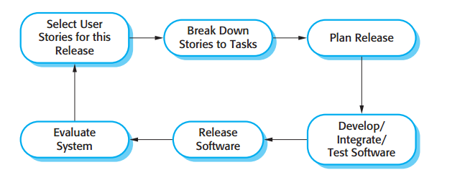
Extreme Programming Release Cycle

Slide 27
What is a user story?
User stories are short, simple descriptions of a feature told from the perspective of the person who desires the new capability, usually a user or customer.
In software development and product management, a user story is an informal, natural language description of one or more features of a software system. A user story is a tool used in Agile software development to capture a description of a software feature from an end-user perspective. A user story describes the type of user, what they want and why. A user story helps to create a simplified description of a requirement of the system.

Slide 28
User Story Examples:
As a [customer], I want [shopping cart feature] so that [I can easily purchase items online].
As an [manager], I want to [generate a report] so that [I can understand which departments need more resources].
As a [customer], I want to [receive an SMS when the item is arrived] so that [I can go pick it up right away]

Slide 29
XP Process-Planning
XP Planning
  Begins with the listening, leads to creation of “user stories” that describes required output, features, and functionality. Customer assigns a value(i.e., a priority) to each story.
  Agile team assesses each story and assigns a cost (development weeks. If more than 3 weeks, customer asked to split into smaller stories)
  Working together, stories are grouped for a deliverable increment next release.

Slide 30
XP Process-Planning
  A commitment (stories to be included, delivery date and other project matters) is made. Three ways:
    Either all stories will be implemented in a few weeks,
    high priority stories first, or
    the riskiest stories will be implemented first.
  After the first increment “project velocity”, namely number of stories implemented during the first release is used to help define subsequent delivery dates for other increments. Customers can add stories, delete existing stories, change values of an existing story, split stories as development work proceeds.

Slide 31
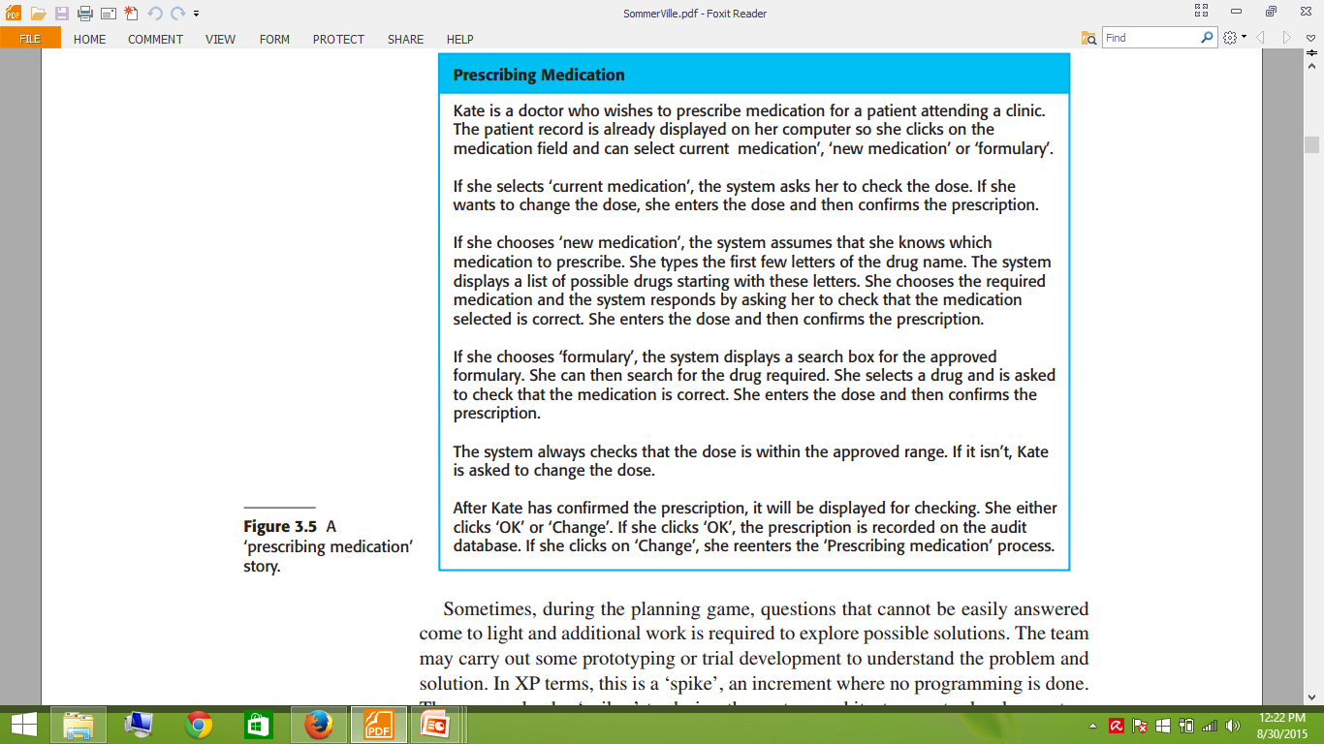

Slide 32
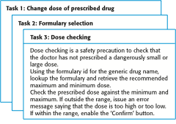
Examples of task cards for prescribing medication

Slide 33
XP Process-Coding
XP Coding
  Recommends the construction of a unit test for a story before coding commences. So implementer can focus on what must be implemented to pass the test.
  Encourages “pair programming”. Two people work together at one workstation. Real time problem solving, real time review for quality assurance. Take slightly different roles.

Slide 34
XP Process-Testing
XP Testing
  All unit tests are executed daily and ideally should be automated. Regression tests are conducted to test current and previous components.
  “Acceptance tests” are defined by the customer and executed to assess customer visible functionality

Slide 35
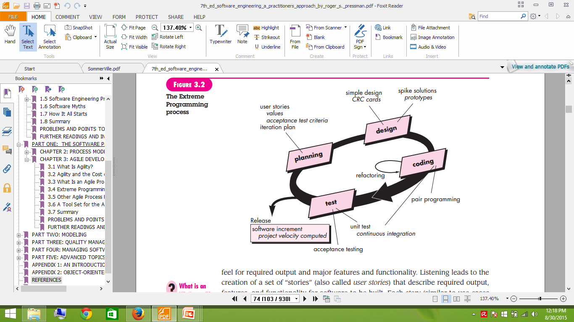
XP Process

Slide 36
When to use XP
Highly-adaptive development. XP was designed to help development teams adapt to fast-changing requirements.
Risky projects. Teams applying XP practices are more likely to avoid problems connected with working on a new system, especially when a product owner sets strict deadlines for a project.
Small teams. XP practices are efficient for teams that don’t exceed 12 people.
Automated testing. Another factor that can influence the choice of XP is the developers’ ability to create and run unit tests.

